Slide 1
Fundamental Network Programming
TCP over SSL in C#
Lecturer: MSc. Dang Le Bao Chuong
Spring 2022

Slide 2
Agenda
TCP over SSL
What is SSL/TLS ?
SslStream in C#

Slide 3
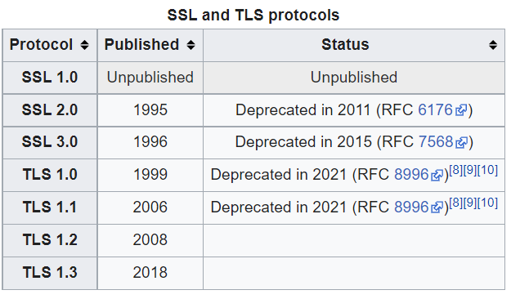
Secure socket layer protocol history
In Aug 1986, an initiative lead by NSA started a project called Secure Data Network System (SDNS), which contained founding principles for today Transport Layer Security Protocol (TLS).
First version of Secure Sockets Layer (SSL) protocol was developed by Netscape Communications Corporation in 1993, but unpublished. Only SSL 2.0, 3.0 was adopted in use for secured connection.
Mature version of TLS which are widely adopted and used today is 1.2 and 1.3.
Notes:
joint initiative begun in August 1986, among the National Security Agency, the National Bureau of Standards, the Defense Communications Agency, and twelve communications and computer corporations who initiated a special project called the Secure Data Network System (SDNS)

Slide 4
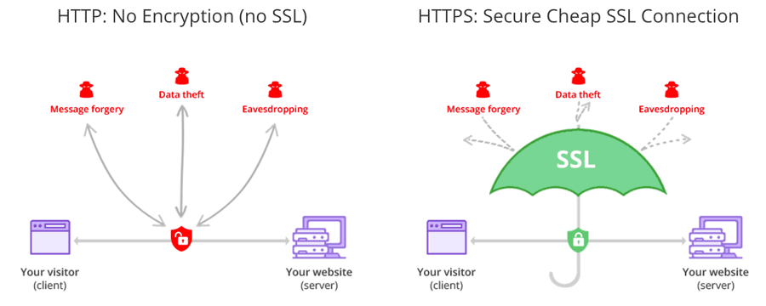
Network communication SSL vs. no-SSL

Slide 5
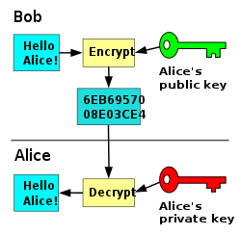
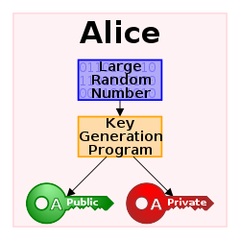
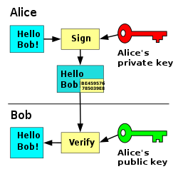
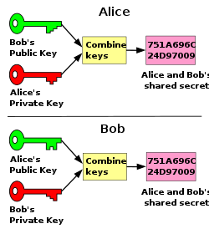
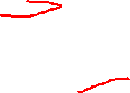
Digital certificates – Public key cryptography
asymmetric key encryption scheme
Digital Signature scheme
In the Diffie–Hellman key exchange scheme
Notes:
In the Diffie–Hellman key exchange scheme, each party generates a public/private key pair and distributes the public key of the pair. After obtaining an authentic (n.b., this is critical) copy of each other's public keys, Alice and Bob can compute a shared secret offline. The shared secret can be used, for instance, as the key for a symmetric cipher which will be, in essentially all cases, much faster.

Slide 6
Digital certificates
A digital certificate certifies the ownership of a public key by the named subject of the certificate, and indicates certain expected usages of that key.
This allows others (relying parties) to rely upon signatures or on assertions made by the private key that corresponds to the certified public key

Slide 7
Certificate authorities
TLS typically relies on a set of trusted third-party certificate authorities to establish the authenticity of certificates. Trust is usually anchored in a list of certificates distributed with user agent software, and can be modified by the relying party.
IdenTrust, DigiCert, and Sectigo are the top 3 certificate authorities in terms of market share account for 47%, 18.8% and 16% respectively in Apr 2022.
In X.509 certificate, certificate authorities and a public key infrastructure are necessary to verify the relation between a certificate and its owner, as well as to generate, sign, and administer the validity of certificates

Slide 8
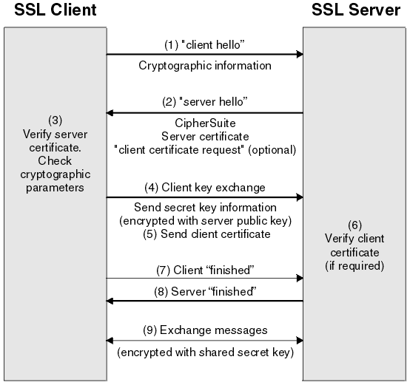
Establish SSL/TLS handshake
Notes:
This section does not attempt to provide full details of the messages exchanged during the SSL handshake. In overview, the steps involved in the SSL handshake are as follows:The SSL or TLS client sends a “client hello” message that lists cryptographic information such as the SSL or TLS version and, in the client's order of preference, the CipherSuites supported by the client. The message also contains a random byte string that is used in subsequent computations. The protocol allows for the “client hello” to include the data compression methods supported by the client.
The SSL or TLS server responds with a “server hello” message that contains the CipherSuite chosen by the server from the list provided by the client, the session ID, and another random byte string. The server also sends its digital certificate. If the server requires a digital certificate for client authentication, the server sends a “client certificate request” that includes a list of the types of certificates supported and the Distinguished Names of acceptable Certification Authorities (CAs).
The SSL or TLS client verifies the server's digital certificate. For more information, see How SSL and TLS provide identification, authentication, confidentiality, and integrity.
The SSL or TLS client sends the random byte string that enables both the client and the server to compute the secret key to be used for encrypting subsequent message data. The random byte string itself is encrypted with the server's public key.
If the SSL or TLS server sent a “client certificate request”, the client sends a random byte string encrypted with the client's private key, together with the client's digital certificate, or a “no digital certificate alert”. This alert is only a warning, but with some implementations the handshake fails if client authentication is mandatory.
The SSL or TLS server verifies the client's certificate. For more information, see How SSL and TLS provide identification, authentication, confidentiality, and integrity.
The SSL or TLS client sends the server a “finished” message, which is encrypted with the secret key, indicating that the client part of the handshake is complete.
The SSL or TLS server sends the client a “finished” message, which is encrypted with the secret key, indicating that the server part of the handshake is complete.
For the duration of the SSL or TLS session, the server and client can now exchange messages that are symmetrically encrypted with the shared secret key.

Slide 9
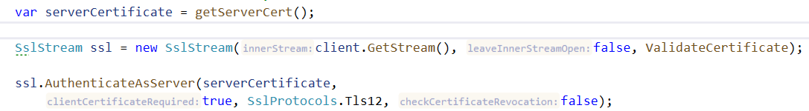
SSL support in C#
SslStream is class which enable SSL/TLS communication for Socket, TcpClient, TcpListener classes.
Wrapping NetworkStream into SslStream class and using the Certificate, then we could secure the connection

Slide 10
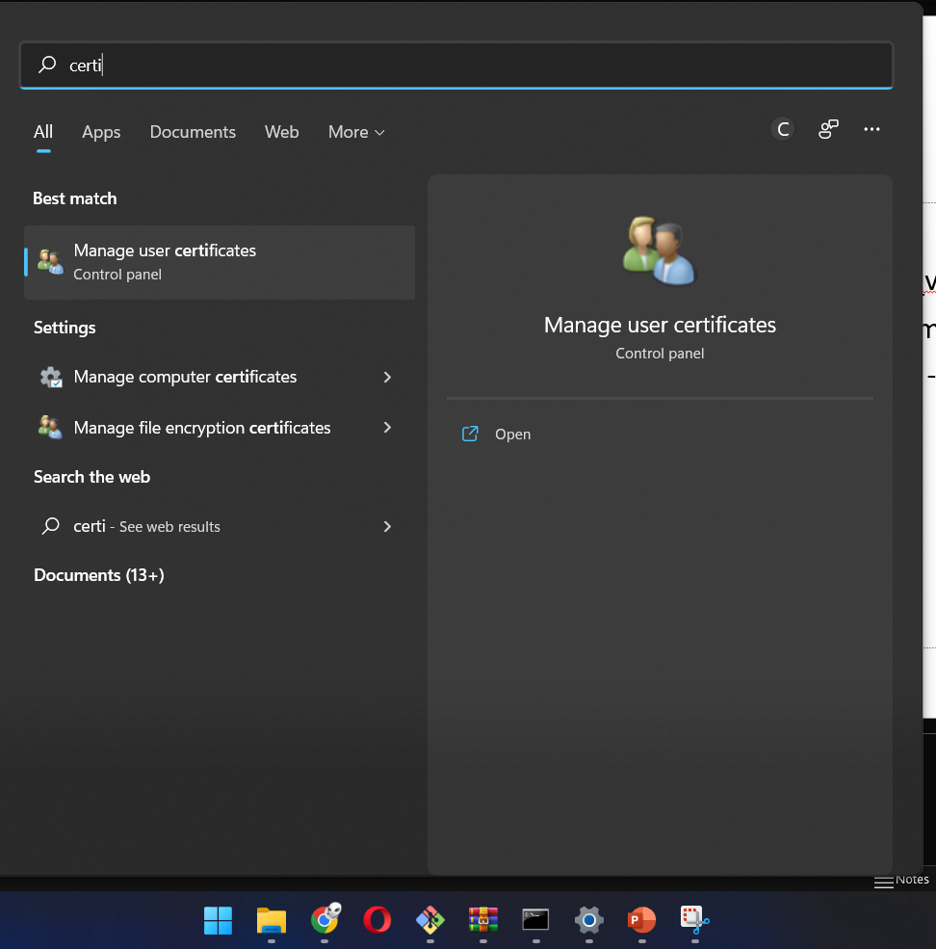
Create digital certificate for SSL
Required: installed visual studio Window SDK 10.x
Go to: C:\Program Files (x86)\Windows Kits\10\bin\10.0.{build_version}\x86
Open command line prompt inside above folder and type this command:
makecert.exe -r -pe -n "CN=MySslSocketCertificate" -b 01/01/2022 -e 12/31/2022 -sk exchange -ss my
Then, press “Window key” ,
search for “Certificate”

Slide 11
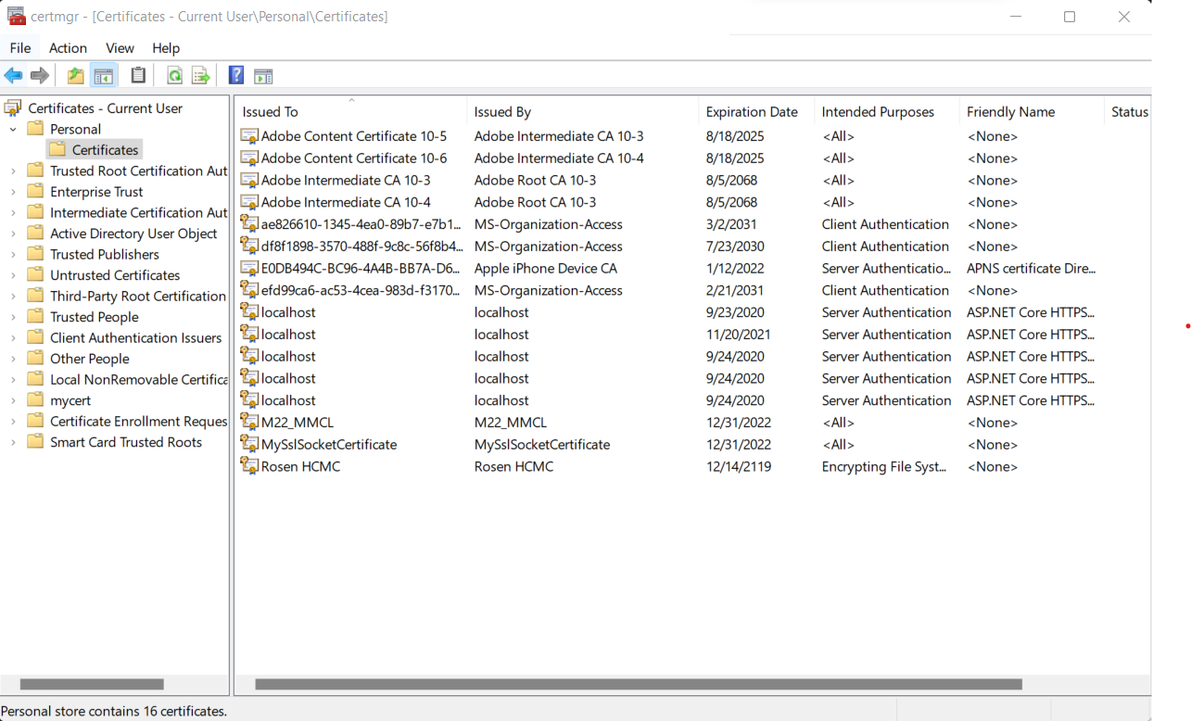
Create digital certificate for SSL
Your certificate will be stored at: Certificate –Current User/Personal/Certificates

Slide 12
References
https://en.wikipedia.org/wiki/Transport_Layer_Security
https://en.wikipedia.org/wiki/Public-key_cryptography
https://www.ibm.com/docs/en/ibm-mq/7.5?topic=ssl-overview-tls-handshake
https://docs.microsoft.com/en-us/dotnet/api/system.net.security.sslstream?view=net-6.0

Slide 13
No assignment this week
Last Q&A about the final project

